Slide 1
DHIS2 v 40 Offline Installation Guide and FAQs
Ministry of Health(MOH)

Slide 2
1. Pre-installation Activities
Export historical data
Verify the exported file to ensure it contains the correct data
uninstall the previous DHIS2 components
Uninstall DHIS2
Revo uninstall
Manual Uninstall
If need be clear from the registry
Restart the Computer

Slide 3
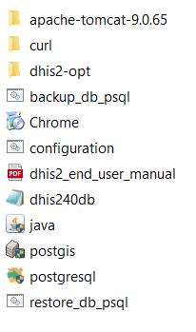
2. Install the DHIS2 v 40 installer (file name should be the same with DHIS2v 40windows64bit-26c771b_25082024)
Download the recent installer file from https://repo.moh.gov.et/dhis2/hmis/v40 or from reliable source
Components….>

Slide 4
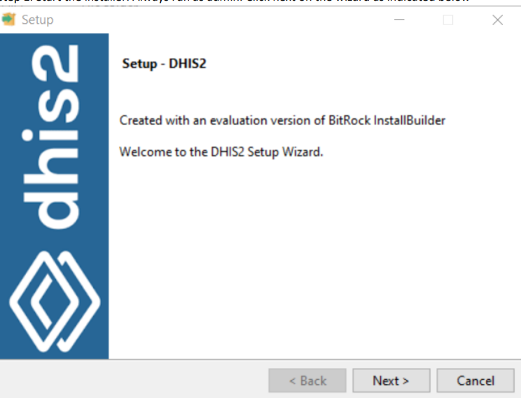
Step 1. Start the installer
Always run as admin. Click next on the wizard as indicated below

Slide 5
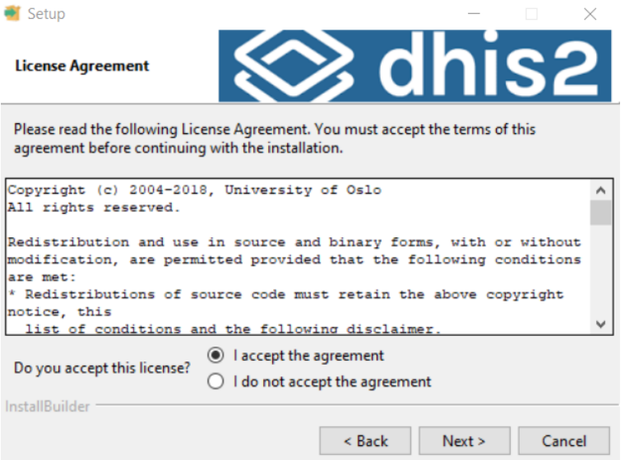
Step 2. On the license
On the license agreement wizard select I accept the agreement and click next

Slide 6
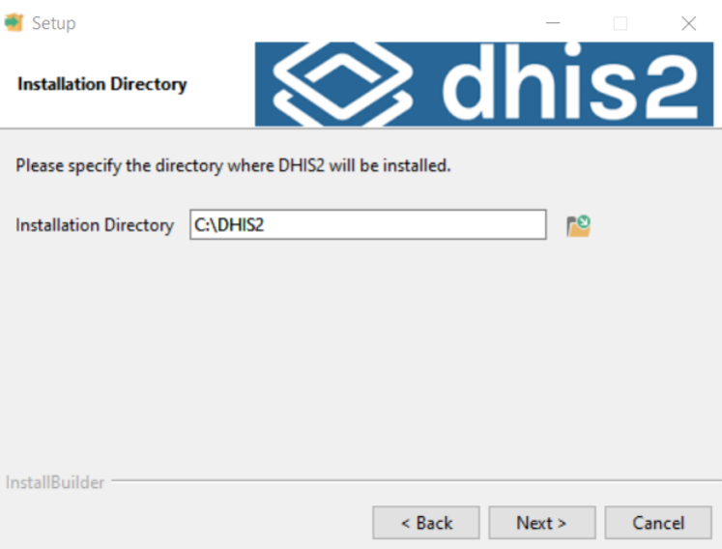
Step 3. Directory of installation
It automatically start the wizard with the installation directory and leave as it is. It should install inside c:\DHIS2 directory. Click next

Slide 7
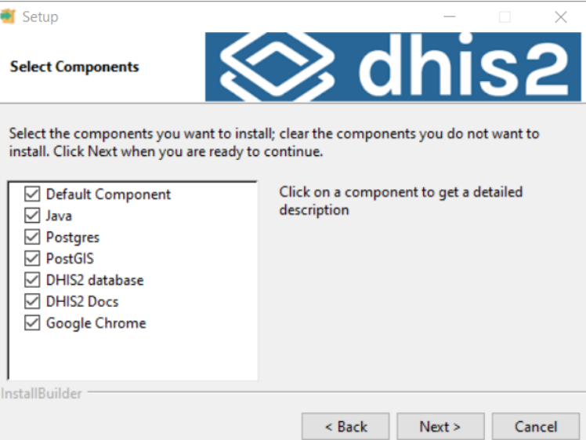
Step 4: Select the components to install
The next step is to select the components to install. Select all the components, and click next.

Slide 8
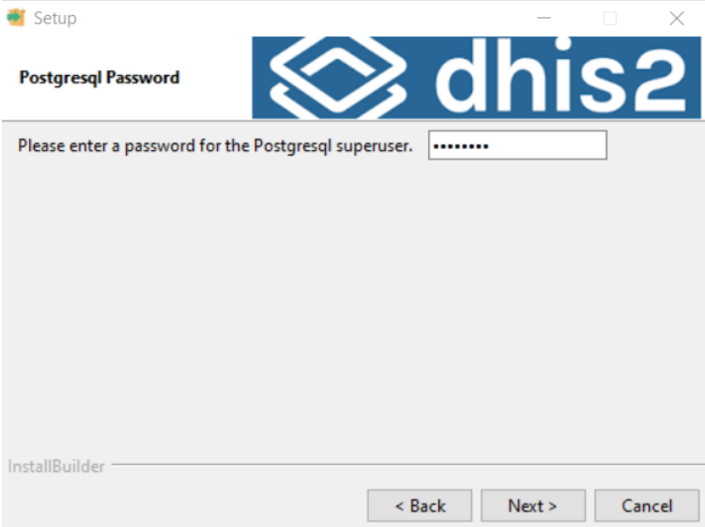
Step 5: Sets the postgresql password.
In the following wizard it sets the postgresql password. DO NOT CHANGE, leave as it is and click next

Slide 9
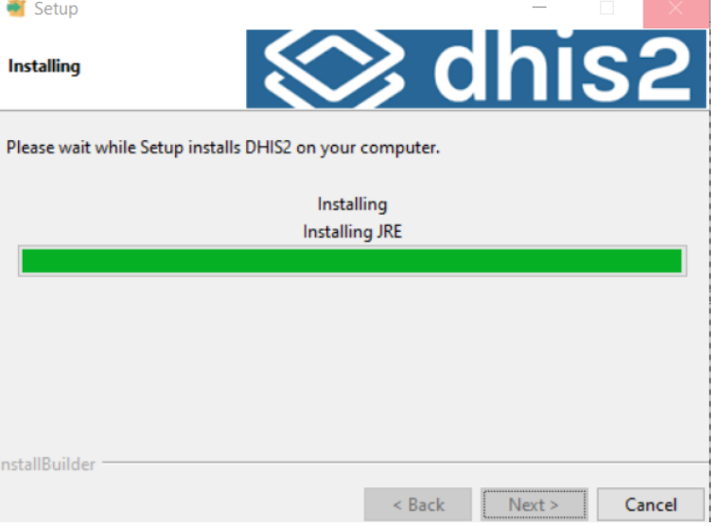
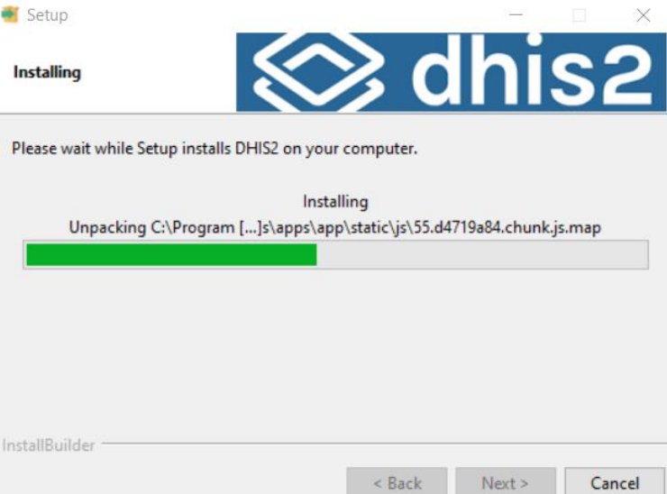
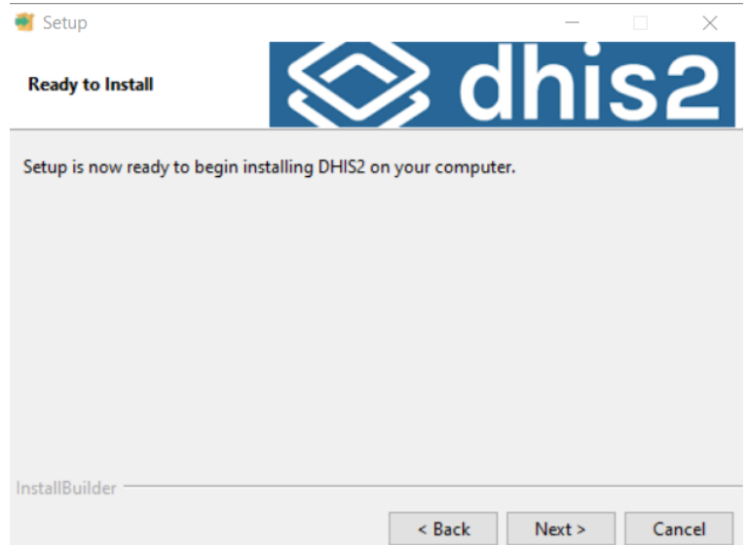
Step 6,7,8: Click next on the following wizard

Slide 10
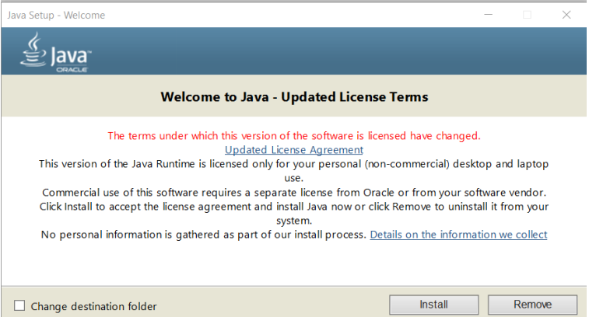
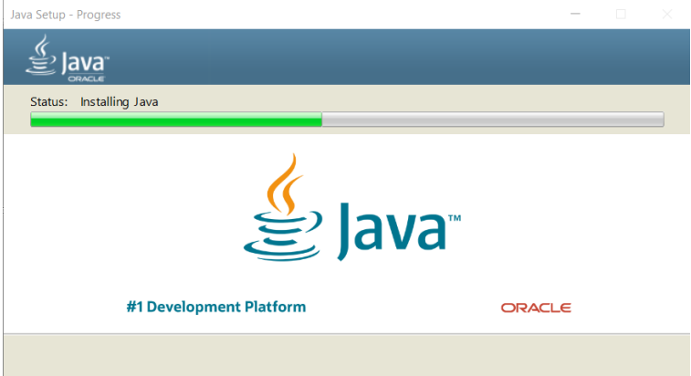
Step 9: Install the JDK components
It displays a dialog to install the JRE components as indicated on the following dialog, click install and continue

Slide 11
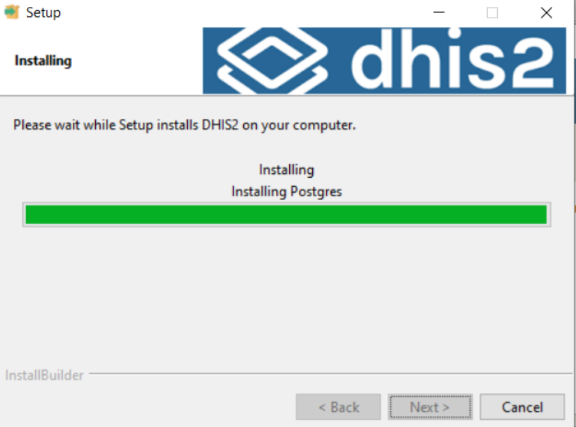
Step 10: install Postgresql
The next step is to install Postgresql, also populate the licensee agreement and click next

Slide 12
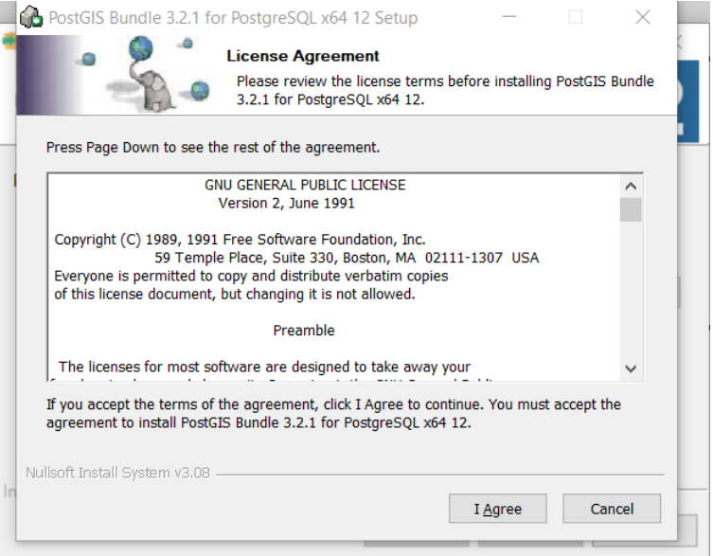
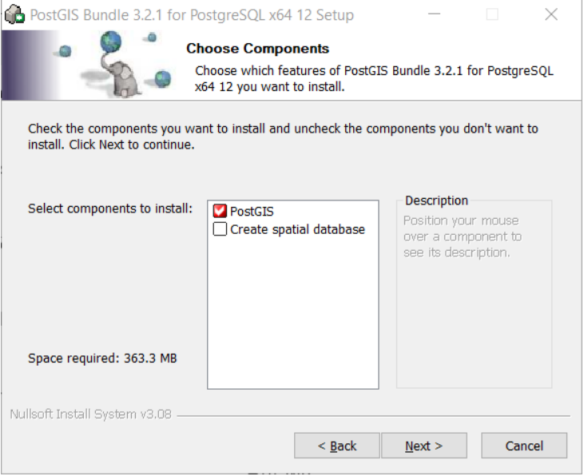
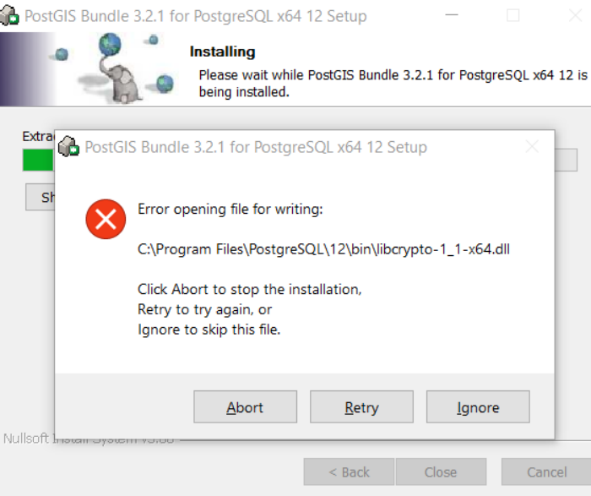
Step 11: Install the Postgis
The next step install the Postgis, click the I agree
On the following dialog box, DONOT SELECT spatial database

Slide 13
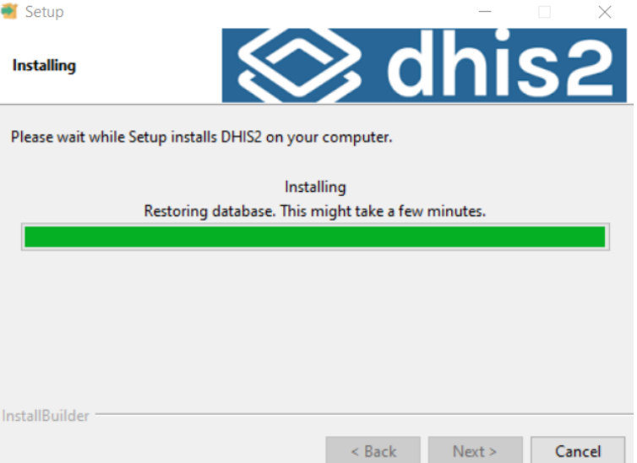
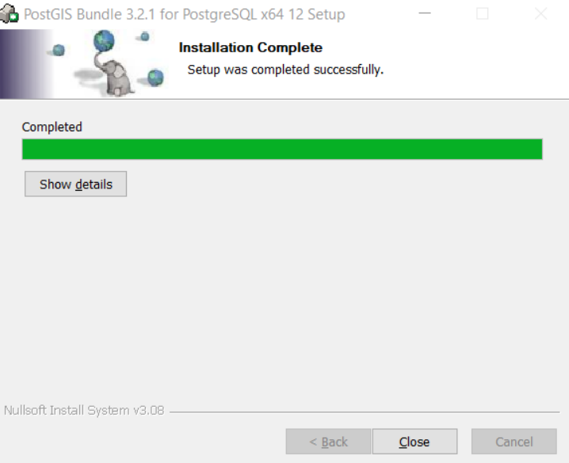
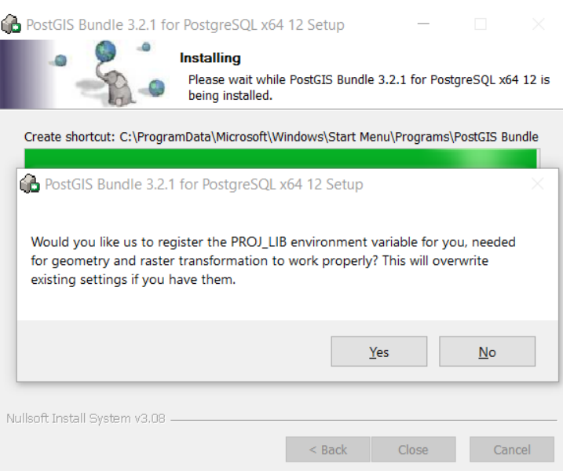
Step 12: Finalizing Postgis Installation
Click Yes and then finally close button

Slide 14
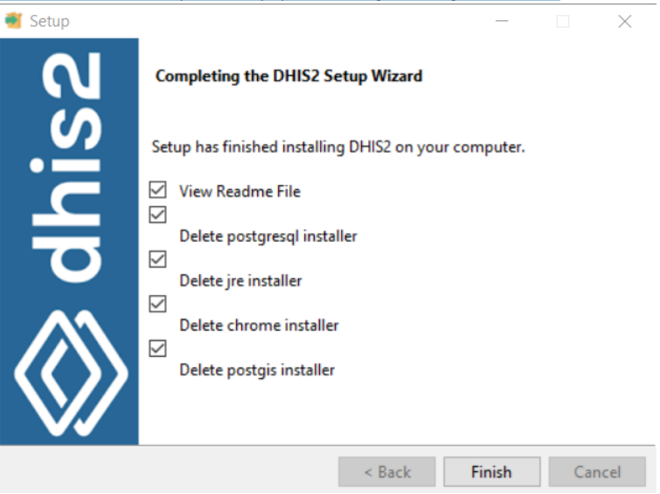
Step 13: The final stages
Database Restoring,
Chrome installation,
Starting Tomcat,
creating shortcut
Finalizing

Slide 15
Frequently Asked Questions(FAQs)
S/N | Issue | Solution
1 | Duplication of data on visualizer and custom dataset reports | Originally the DB was not indexed Browsers other than chrome have a potential to generate duplicates Scripts generated to removeduplicates
2 | Data entered/captured but not viewed on visualizer even after executing the analytics | Analytics takes only the “last updated” Future data entered in the DB CMOS Change, Fixing date on computer Period structure issue- solved with period structure rebuild Future Date was changed with json Send the list of facilities with problem with CMOS issue and compile the facilities with issues of future date(Report on SQL view: select * from datavalue where periodid in (select periodid from period where periodtypeid = 10 and startdate > '2024-01-11'); Suspect that it could be system problem?

Slide 16
Frequently Asked Questions(FAQs)
S/N | Issue | Solution
3 | Summation problems(the sum of the disaggregation doesn’t equal to the value on the data element) | Cause: Mix of category structure, wrong and correct Query was generated and frequently run to solve the issue One of the causes for the upgrade
4 | The Online and offline instances are not the same(I can login on the online but not on the offline) | cause: Privilege issue Appropriate user privileges should be provided Password change should be properly regulated. Password change policy should enforce polcies Governance document for standerdization
5 | I wanted my shape files created with GIS tools in DHIS2 and able to use it | Admins are politically sensitive and should only taken from recognized body Point data should be populated Technically it is easy to capture point data From maps→ view profile—>capture facilites. Regions please please capture the remaining point data for facilities as fast as you can. Specify the source.

Slide 17
Frequently Asked Questions(FAQs)
S/N | Issue | Solution
6 | Duplication of data on visualizer and custom dataset reports | Orginally the DB was not indexed Browsers other than chrome have a potential to generate duplicates Scripts generated to removeduplicates
7 | Data entered/captured but not viewed on visualizer even after executing the analytics | Analytics takes only the “last updated” Future data entered in the DB CMOS Change, Fixing date on computer Period structure issue- solved with period structure rebuild Future Date was changed with json Send the list of facilities with problem with CMOS issue and compile the facilities with issues of future date(Report on SQL view: select * from datavalue where periodid in (select periodid from period where periodtypeid = 10 and startdate > '2024-01-11'); Suspect that it could be system problem?

Slide 18
Frequently Asked Questions(FAQs)
S/N | Issue | Solution
8 | In trying to capture the data the dataset is empty | Cause could be: Assignment issue, Orgunit grouping issue, Privilege Fix these 3 issues on online and take the copy for offline
9 | After entering the data, it is losing(getting to the form it is not there) | Cause: Privilege issue, and metadata diffrence Proper privilege should be provided
10 | After modifying dataset assignment it displays, “could not save” message | Privilege, taking out data elements from dataset without taking out from section first

Slide 19
Frequently Asked Questions(FAQs)
S/N | Issue | Solution
11 | The reporting rate shown is not correct. Like it displays 20% while it should be above 90% | Analytics might not be executed Wrong data updated period
12 | The IPD/OPD list is not enough for some of the facilities | There is the standard Facility IPD OPD Referral Hospital 40 60 General Hospital 20 30 Primary Hospital 15 25 Health Center 5 12 Health Post 0 1 Clinic 5 10

Slide 20
Frequently Asked Questions(FAQs)
S/N | Issue | Solution
13 | Trying to import on the online instance rejects some of the data | This is due to changed category options
14 | The installer is not able to install on some computers | Let’s document the issues on this
15 | installer is not installing at the frist time even on new computer-at least two times | Configuration is optimized
16 | 404 resource not found or server is not willing to share resources error | Either the application(Tomcat) or Postgres or one of the component is failed to start

Slide 21
Thank you!

