Slide 1
DHIS2 Version 40: Upgrading the National Training of Trainers (ToT)
Adama, Feb. 13, 2024

Slide 2
Outline
Introduction
Rational for version upgrades and other updates
Customization process
Key Changes in metadata, data entry, visualization, and analytics
New futures for DHIS2 version 40
Challenges and Considerations
Next Steps and Priorities

Slide 3
Introduction
Overview of current DHIS2 implementation status
Version 2.27 implemented in 2018
Upgraded to versions 2.30 and 2.36
55% of health facilities now online
30,763 facilities & 1,103 admin units using system
Capacity Building: Continuous training and support provided to healthcare personnel for effective DHIS2 utilization.

Slide 5
Reasons for upgrading to v 40
Fix metadata and data quality issues
Get latest analytics features
Better community support
Redeployment Dilemma: the high cost and complexity of redeploying DHIS2 v2.36 with fixes for offline facilities.
Cost-Effectiveness: DHIS2 v40 upgrade eliminates the need for expensive redeployment and offers valuable new features

Slide 6
Process steps for Customization
Conducted two rounds of the 15-day workshop
Used MoH and regional experts for metadata cleaning , customization and overall testing
Conducted Nonfunctional , Functional pilot testing, User acceptance Testing and Technical Training

Slide 7
Process Steps for Customization
Step 1: Identifying Issues:
Review and categorize DHIS2's Known issues into 16 key areas
Step 2: Crafting a Plan:
Develop action plan with defined tasks and timelines
Step 3: Team Grouping:
Form groups based on their individual expertise
Step 4: Setting Standards:-
Establish a dedicated team to define data quality standards and Review
Step 5: Strong Monitoring:
Regularly monitor and assess ongoing activities

Slide 8
Major issues resolved in relation to metadata
Category options: 307 of the 634 initial category options were retained after review and removal of redundancies.
Categories: Initially, 253 categories were identified for cleaning, with 134 high-priority categories chosen for inclusion in the data collection.
Category Combinations: Out of 271 category combinations, 136 were accepted after team review and revision.
Standardized naming: Consistent naming procedures are implemented for all metadata.
Removed duplicate indicators, data elements, and validation rules
Fix formula issues for indicator calculation

Slide 9
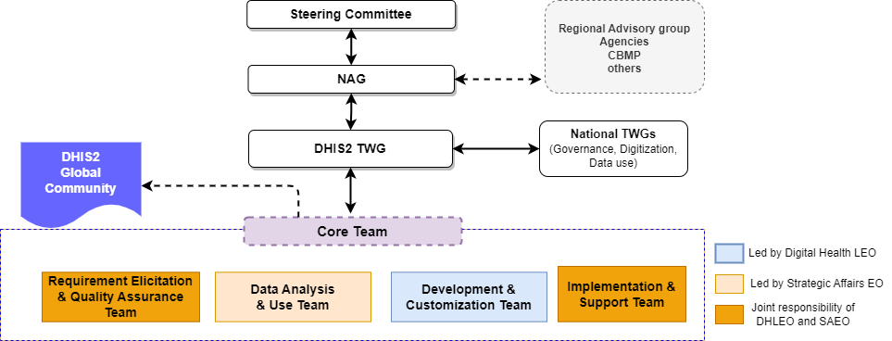
Developing the DHIS2 governance protocol and implementation roadmap
Completing the final draft of the DHIS2 governance protocol
Initiating the development of a draft implementation roadmap

Slide 10
DHIS2 Governance Protocol: Key Messages
Defines roles and responsibilities for requirement gathering, development, customization, and data use.
Outline procedures for user management, access controls, and data sharing.
Establishes standards for development, upgrade, integration, and interoperability.
Specifies infrastructure requirements and a readiness checklist.
Ensures smooth operations, user satisfaction, data-driven decisions, and health system support.

Slide 11
Key Changes in metadata, Data Entry, Visualization, and Analytics

Slide 12
Access to the DHIS2 staging server
URL :https://hmis-staging.moh.gov.et/
Username and password: Your production username and password

Slide 13
Standardizing Naming Conventions for Data Elements and Indicators
Added prefixed before the actual name ( useful in filtering a long list of name).
Enhance clarity and ease of interpretation for analysis and reporting.
Form Name:
Appears solely in data entry forms.
No anticipated modifications (identical to reporting forms).
Example: "Total number of pregnant women that received four or more antenatal care contacts by Maternal Age"
Name:
Used for data analysis and reporting.
Character limit: 255 characters.
Example: "MAT_ANC >= 4 by Maternal Age "
Short Name:
Used for graphical visualizations and concise presentations.
Ideal for graphs, maps, and other presentations.
Character limit: 50 characters.
Example: " ANC >= 4 by Maternal Age“
Procedure to Change Name to Short Name:
Navigate to: Settings > User Settings > Property to Display in Analysis Module > Short Name

Slide 14
Validation Rules
An expression that defines a relationship between a number of data elements
Expression has Left side, right side and an operator
Common operators are: less than, equal to or greater than
You create Validation Rules based on what you know to be true
e.g.
‘Malaria RDT positive’ should always be LESS THAN ‘Malaria RDT tested’

Slide 15
Validation Rules…Continued
Total Validation Rules: 626
Valuation Groups = 18
Added prefixed before the actual name of the validation rules.
Determine the importance of the validation rule as
Low…5
Medium…226
High…395 (Most of them are Hospital KPIs and HSTQ related data elements)
Grouped validation rules based on the thematic area.
This group is what you will select in Validation Rule Analysis
The output will test every rule in the Group and show you EVERY TIME a rule was violated within your specified time and place!
validation rules across data set work only in the data quality app.
https://docs.google.com/spreadsheets/d/16bM8vubRiqN3u58ZW3QIsaoEVH5nqJ1o/edit#gid=1113344084

Slide 16
Routine Data Entry
Introducing Control Groups :
30 control groups were added to the monthly reporting dataset.
All control groups are closed by default.
Benefits:
Service availability data for program improvement including private HFs.
Enhanced data analysis capabilities to service availability monitoring.
All data entry datasets are to be closed after 3 months.
Rationale:
Defines a timeframe for data entry completeness.
Facilitates accurate reporting and analysis with finalized data.
Ensures data consistency and prevents conflicting updates.
Next : Steps
Train users on identifying and utilizing control groups.
Communicate the closure policy and its benefits to stakeholders.

Slide 17
Data Quality (Core App)
Validation Rule Analysis:
Powerful tool for cross-comparing various data elements across different datasets.
Outlier Detection:
Utilizes both Z-score and modified Z-score methods for comprehensive outlier identification.
Enables targeted investigation and data corrections when needed.
Follow-Up Analysis:
Streamlined flow for further analysis and resolution of identified data issues.
Notes:
Open the Data Quality app and click Outlier Detection.
Select one or multiple data sets.
Select Organisation units. Multiple organisation units can be selected. The analysis is made on raw data for all organisation units in the sub-hierarchy of the selected units, not on aggregated data.
Select From date and To date.
Set the Algorithm to use. Z-score (based on the mean of data values), Modified Z-score (based on the median of data values) and Min-max values (based on stored min-max data values) are available algorithms.
Select a Threshold.
This refers to the number of standard deviations the data is allowed to deviate from the mean before it is classified as an outlier.
Select Max results.
This refers to the maximum number of outliers listed in the results.
(Optional) Select a Data start date and Data end date
These fields can be used to perform outlier detection analysis on a subset of the data within the provided date range. When left blank, the natural start and end date of the dataset will be used (in advanced section).
(Optional) Select a measure to Sort by.
The outliers can be sorted by Z-score or by Absolute deviation from Mean (in advanced section).

Slide 18
LQAS (Data Accuracy) Check
A New App for Enhanced Accuracy Assessments:
Randomly selects 12 samples from the dataset for verification.
Compares manual registration counts with reported values in the based-on Lot Assurance Decision Table.
Offers downloadable reports in various formats for flexibility and documentation.
Implements an audit trail for transparent tracking of all accuracy checks.

Slide 19
Content Completeness
Automated Calculation:
The system automatically calculates the percentage of content completeness.
Provides a clear overview of data comprehensiveness.
Downloadable reports in various formats are available for convenient analysis and sharing.

Slide 20
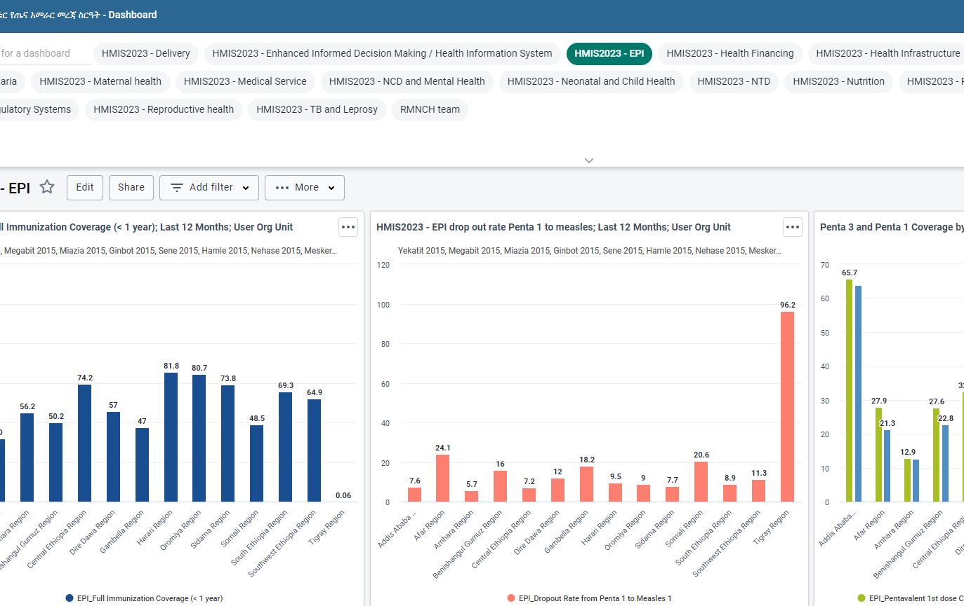
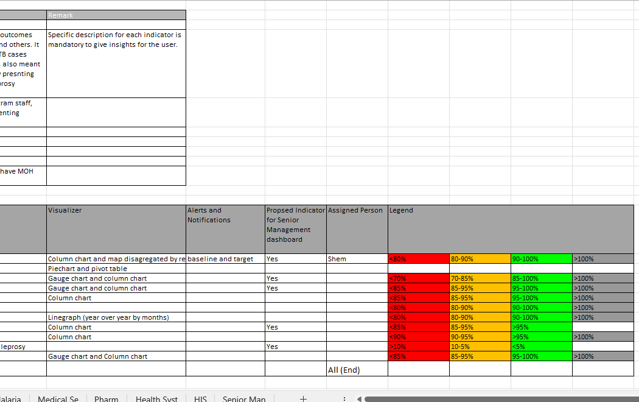
Visualization and Analytics
As of DHIS2 version 2.37, the dedicated Pivot Table app has been integrated into the Data Visualizer app.
DHIS2 Dashboard Enhancements: Standardization
Standardized Dashboards:
Defined indicator descriptions, focused selection, clear visualizations, timely alerts, and consistent legends
Senior Management Focus:
A tailored dashboard emphasizes key metrics for informed decision-making.
Program Coverage:
12 major programs and 22 sub-programs are integrated for a comprehensive dashboard.

Slide 21
Scorecard and BNA
Ethiopian Calendar Configuration
BNA Draft Intervention Customization
Targeted User Training

Slide 22
Revision of Hospital KPI indicators
Data Entry Expected at Public hospital Level on Monthly and Quarterly Basis
Capturing 30+ data elements and key indicators
Provision of stand-alone training

Slide 23
Integration of MRIS and Rehabilitation
Multi-Sectoral Response Information System (MRIS):
Data Entry Expected at Woreda Level on a Quarterly Basis
Capturing 15+ data elements and key indicators for a multi-sectoral response to HIV services
Provision of stand-alone training
Rehabilitation Information:
Expected Monthly Data Entry at the Facilitates Level
Capturing of 9 Data Elements and Key Indicators to track and manage rehabilitation data
Approximately 40 facilities offer rehabilitation services.
Provision of stand-alone training

Slide 24
Integration of Compressive health post data set
Expanded dataset for comprehensive health post-services
Currently we have 50 comprehensive health posts in DHIS 2
Introduction of Nine New Datasets for Comprehensive Health Posts

Slide 25
Integration of Urban HC and Merged HP data set
Integration of Health Post and Urban Health Center data for a holistic health center Performance measurement.
Both urban HC and HC with merged HP used the same datasets.
The data entry is expected monthly and quarterly.
No Additional Data elements: Leveraging existing data elements aligned with the 2021 indicator revision.

Slide 26
Integration of Composite IR Score
Automated Calculation Based on Composite Measure
Calculation Methodology Aligned with IR Guidelines
Woreda IR Score: Assessing Overall Performance, Including Woreda Health Office and Supervised Facilities
PHCU IR Score: Measure PHCU Performance, Including Satellite Health Post and Health Center

Slide 27
Integration of Woreda Transformation Dashboard
Dashboard for monitoring and visualizing the transformation progress at the Woreda level.
Automated Calculation Utilizing Composite Measures
Calculation Methodology Aligned with Woreda Transformation Guidelines
Facility-Level Calculation Based on Catchment Population Entered in DHIS2

Slide 28
Integration of Woreda based plan
Introduction of a dataset for Woreda-based planning
Baseline Data Automatically Calculated from the Previous Year's Performance
Selection of Indicators for the Woreda-Based Plan Aligned with the DHIS2 Indicator Reference Guide
The customization process is nearing completion.

Slide 29
Introduced new features and enhancements
(DHIS2-V40)

Slide 30
Version 40
Dropping the 2 from the release version numbers
DHIS2 Version 40
This makes it easer to communicate what is the major release numbers
DHIS2" is now the official brand name.
There is no need for abbreviations like "District Health Information System 2."

Slide 31
Dashboard default layout:(DHIS v2.37)
Dashboards support automatic configuration as items are added.
Option to select the number of columns for layout.
Users can choose to add new items to the top or bottom.
Items adjust size and shape based on column selection.

Slide 32
Cascading Dashboard Sharing: (DHIS v2.37)
Share dashboards seamlessly with other users.
Sharing cascades to include items like visualizations, maps, reports, etc.
Simplifies the sharing process, eliminating manual sharing of individual items.

Slide 33
Offline Dashboards: (DHIS2 v2.37)
Users can now mark dashboards for offline access.
Visualizations and data are stored locally in the web browser for laptops, desktops, and mobile devices.
Offline access allows viewing dashboards without an internet connection.
Note: Filters and interpretations are not supported offline.

Slide 34
Legend Info in Dashboards (DHIS2 v2.37)
View legend information for pivot tables or charts with applied legend sets.
Enable it from Options > Legend for a better understanding of the data.

Slide 35
Line Lists on Dashboards:(DHIS2 v 40)
Access line lists directly on dashboards for comprehensive data management.

Slide 36
Org Unit Drill Down: (DHIS2 v2.37)
Bar and column charts allow easy navigation through the organizational hierarchy.
Users can drill down or move up one level with a simple click.
Available unless the organization unit dimension is specified as a filter.

Slide 37
Freeze Row and Column Headers: (DHIS2 v2.37)
Pivot table headers can now be frozen.
Allows scrolling through large tables while retaining header visibility.
Enable it from Options > Style for seamless navigation.

Slide 38
Text Wrapping: (DHIS2 v2.37)
Pivot tables now support automatic text wrapping.
Ideal for displaying narratives and lengthy data.
Enhances readability within the visualizer app.

Slide 39
On-the-fly Custom Calculations in Data Visualizer: :(DHIS2 v 40)
Easily create custom calculations directly in the Data Visualizer application.
No admin access is required; calculations are automatically saved to pivot tables.
This feature is ideal for exploring coverage calculations with various population denominators

Slide 40
Axis Labels for Multi-Axis Charts:
Customize labels for all axes in multi-axis charts.
Applies to bar, column, and line charts in the Data Visualizer app.
Enhances the clarity and interpretation of data.

Slide 41
Legend for Stacked Column Charts: :(DHIS2 v 40)
Add legends to stacked column charts for improved data visualization.

Slide 42
Single Value Charts with Legend Colors: :(DHIS2 v 40)
Apply legend colors to the background of single-value charts.
Enhances visual engagement and understanding of data significance.

Slide 43
Indicator Sub-Expressions: :(DHIS2 v 2.38)
Indicators count organizational units based on data element comparisons with fixed values.
Example: subExpression(if (#{vq2q03TrNi} > 500, 1, 0))
Description: Counts units reporting over 500 malaria cases within defined period in analytics app.

Slide 44
Predictor Usage in DHIS2: (DHIS2 v 40)
Predictors define aggregate data value generation from expressions containing aggregate data.
Predicted values may be based on data from the same period as well as previous periods.
Data from the same period:
Predictors utilize data from the same period.
Example: Counting non-zero data element values across organization units using the expression: if( #{ji7o0ILHuU2}!= 0, 1, 0).
Result: Stores 1 if a non-zero value exists; otherwise, stores 0.
Data from previous periods:
Predictors utilize data from previous periods when aggregation functions like sum() or avg() are specified.
Example: Generating a value as the average plus twice the standard deviation of previous period data using: avg( #{ji7o0ILHuU2}) + 2 * stddev( #{ji7o0ILHuU2}).

Slide 45
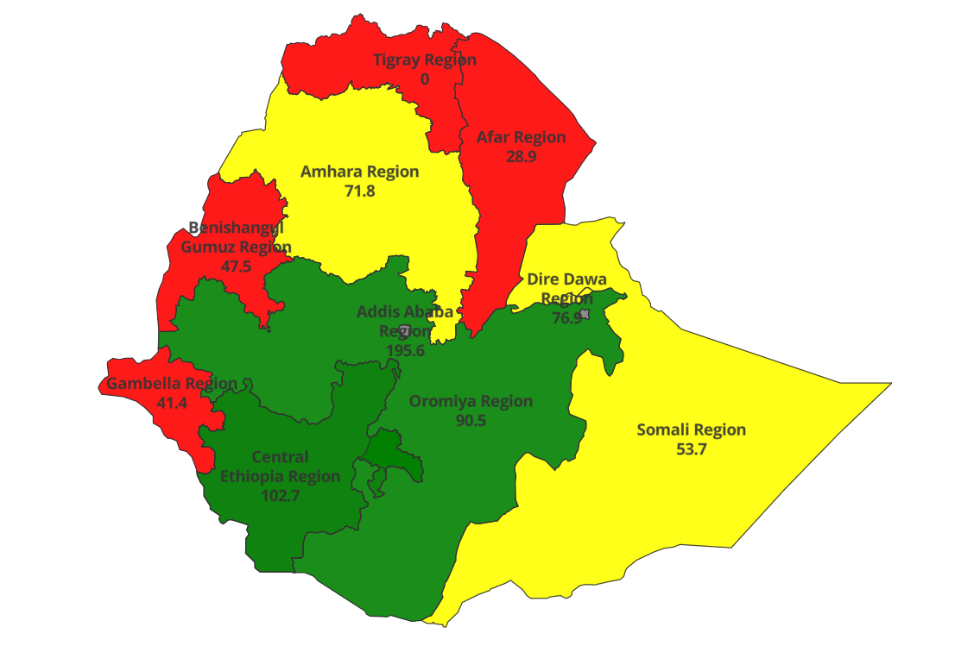
Display values in thematic layers: :(DHIS2 v 40)
Show values directly on maps in thematic layers for enhanced data presentation.

Slide 46
Improved Maps Download: :(DHIS2 v 40)
Download maps with all essential information, including title, description, legend, etc., in one image.

Slide 47
Facility Map Layer: (DHIS2 v2.37)
New map layer in Maps app supports facility registry system in DHIS 2.
Selected level automatically applies when creating a new facility map layer.
Useful in conjunction with new organizational unit profile.

Slide 48
Org unit profile (DHIS2 v2.37)
New Org Unit Profile within the Maps application displays crucial details for each facility directly on the map.
Simply click on a point or facility and select "Show more info" to access the profile.
This powerful feature elevates DHIS2's suitability as a comprehensive facility registry.

Slide 49
Indicator Icons for Single Value Charts: :(DHIS2 v 40)
Display icons in single-value charts to represent indicators.
Adds visual representation to the data for better comprehension.

Slide 50
Modified Z-score: (DHIS2 v2.37)
Introducing outlier detection using the modified Z-score method.
More resilient towards outliers compared to traditional methods.
Available in the data quality app for enhanced data analysis.

Slide 51
Google Earth Engine Building/Structures Layer:
View structure outlines from Google's Open Building dataset in the Maps app.
Beneficial for population estimation, urban planning, and humanitarian response.
Improved performance using web workers.

Slide 52
Hands-on Exercise-1
Using Data Visualizer:
Select Data Elements:
Choose relevant data elements from the Data Elements Panel.
The data element representing the number of children vaccinated against measles.
Include the data element representing the total population of children in each region.
Create Custom Calculation:
Click on the "Add Calculation" button in the Data Visualizer toolbar.
Define the custom calculation as follows:
Calculation Name: Measles Vaccination Coverage
Formula: (Number of Children Vaccinated against Measles / Total Population of Children) * 100
Apply Custom Calculation:
Drag and drop the custom calculation onto the pivot-table-canvas.
Arrange the layout as desired, adding row and column dimensions, as necessary.
Analyze Results:
Save and Share Results:

Slide 53
Hands-on Exercise-2
Using Data Visualizer:
Select Data Elements:
Choose the relevant data elements from the Data Elements Panel.
Inc the data element representing patient attendance or visits.
Choose Organization Units:
Select the top-level organization unit that encompasses all facilities (e.g., Regional Health Department).
Drag and drop this organization unit onto the column bar chart canvas.
Org Unit Drill Down:
Click on the arrow icon next to the selected organization unit on the column bar chart canvas.
Explore the available sub-levels of organization units (e.g., District Health Offices, Health Centers, Clinics).
Click on a sub-level organization unit to drill down and view data specific to that level.
Analyze Results:
Save and Share Results:

Slide 54
Hands-on Exercise-3
Using Data Visualizer:
Select Data Elements:
Choose the relevant data elements representing CAR data, Method categories, and regions from the Data Elements Panel.
Create Pivot Table:
Drag and drop the selected data elements onto the pivot table canvas.
Arrange the layout as desired, adding row and column dimensions (e.g., Category, Region) for analysis.
Freeze Row and Column Headers:
Navigate to Options > Style > Fix Column Headers to Top of Table and Fix Row Headers to Left of Table.
Enable both options to freeze row and column headers for easier navigation through large pivot tables.
Customize Axis Labels for Multi-Axis Charts:
Select the data elements for the multi-axis chart visualization.
Click on the chart configuration settings.
Customize axis labels by providing descriptive names or units for each axis (e.g., CAR data, Method Categories, Region).
Analyze Results:
Save and Share Results:

Slide 55
Hands-on Exercise-4
DHIS2 Maps :
Select Map Layers:
Choose the relevant map layers representing services data, administrative boundaries, and other spatial information from the available layers panel.
Configure Map Settings:
Customize the map settings, including zoom level, center point, and map projection, to focus on the area of interest.
Enable Improved Maps Download:
Locate the "Download" option in the map toolbar.
Select the "Improved Maps Download" option from the dropdown menu to enable the feature.
Customize Download Options:
Choose the elements to include in the downloaded map image, such as:
Title: Add a descriptive title for the map.
Description: Provide additional context or information about the map.
Legends: Include legends to interpret map symbols and colors.
North Arrow: Add a north arrow to indicate the map's orientation.
Overview Map: Include an overview map to provide spatial context.
Download Map Image:

Slide 56
Hands-on Exercise-5
DHIS2 Maps :
Select Thematic Layer:
Choose the relevant thematic layer representing vaccination coverage data from the available layers panel.
Ensure that the thematic layer is configured to display vaccination coverage rates by region.
Configure Thematic Layer:
Click on the layer configuration settings for the selected thematic layer.
Enable the option to display values on the map directly.
Customize Display Settings:
Adjust the display settings, such as font size, color, and placement, to ensure the values are easily visible and legible on the map.
Review Thematic Map:
View the thematic map with values displayed directly on the map for each region.
Analyze the map to identify areas with high and low vaccination coverage rates based on the displayed values.
Interact with Thematic Map:
Use the map navigation tools to zoom in and out or pan across different regions for detailed analysis.
Save Thematic Map:

Slide 57
Hands-on Exercise-6
DHIS2 Dashboard Module:
Create or Select Dashboard:
Choose an existing dashboard containing relevant data visualizations, or create a new dashboard based on your analysis requirements.
Share Dashboard:
Click on the "Share" or "Share Dashboard" button to access the sharing options.
Enable the Cascading Dashboard Sharing feature to automatically share all items within the dashboard, including visualizations, maps, reports, and data elements.
Specify the users or user groups with whom you want to share the dashboard.
Configure Legend Info:
Access the settings or options for each visualization or map within the dashboard.
Enable the option to display legend info for each visualization where a legend set is applied.
Customize the legend settings, such as legend position, orientation, and format, to ensure clarity and consistency across visualizations.
View Shared Dashboard:
Log in with the credentials of the shared users or user groups to access the shared dashboard.
Navigate to the dashboard section to view the shared dashboard with all its components.
Interact with Dashboard:
Explore the shared dashboard by interacting with the visualizations, maps, and reports.

Slide 58
Challenges and Considerations
Legacy Data and Offline Facilities
MFR Data Quality and Coordination
Outdated desktop computer

Slide 59
Next Steps and Priorities
Finalize the Legacy Data Migration
MFR interoperability
Prioritize hardware upgrades: procure computers
Address connectivity gaps
Optimize ICT Infrastructure
Governance and Implementation: official endorsement for the DHIS2 governance protocol and finalizing the implementation roadmap
Invest in capacity-building
Mobile Android App Ethiopian Calander configuration

Slide 60
Regional Cascading and Offline Deployment Plans

Slide 61
Regional Cascading and Offline Deployment Plans: Outline
Background:
Briefly describe the geographic scope of your region and the nature of the offline deployment needed
Deployment Strategy:
Offline Deployment Plan: Identifies critical tasks and backup systems necessary for data management during offline scenarios.
Regional and Cascading Training Approach and Strategy:
Training Participants, Schedule, and Budget:
Draft timeline for training sessions,
Participants involved and
Estimated budget requirements.
National Support:
Briefly mention 1–2 areas where national support would be helpful.
Challenges: Briefly mention 1-2 potential challenges and proposed solutions.
Recommendations

Slide 62
Regional Presentation and Discussion
Prepare both a Word document and presentation slides (no more than 15 slides).
Each region presents for 10 minutes.
Followed by a broader discussion.

Slide 63
Thank you

